Slide 1
Algorithm
Lecture #11
Dr.Sohail Aslam

Slide 2
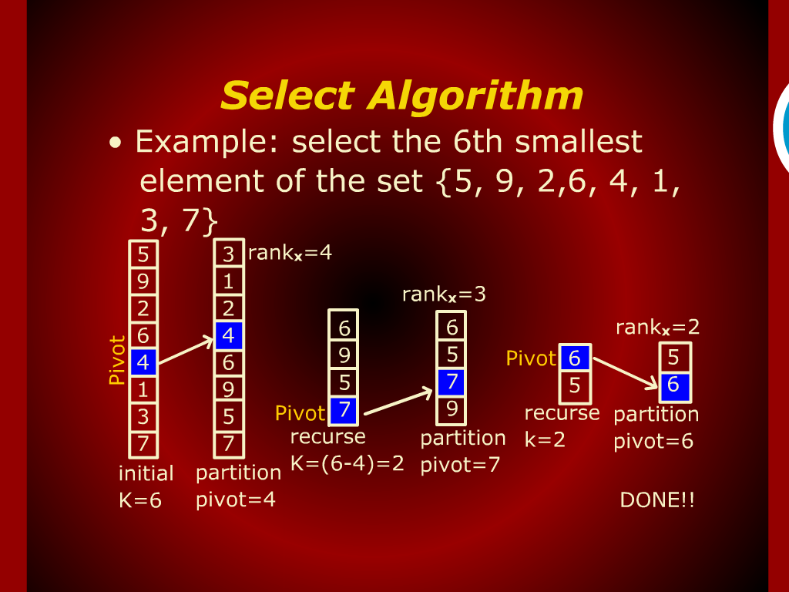
Select Algorithm

Slide 3
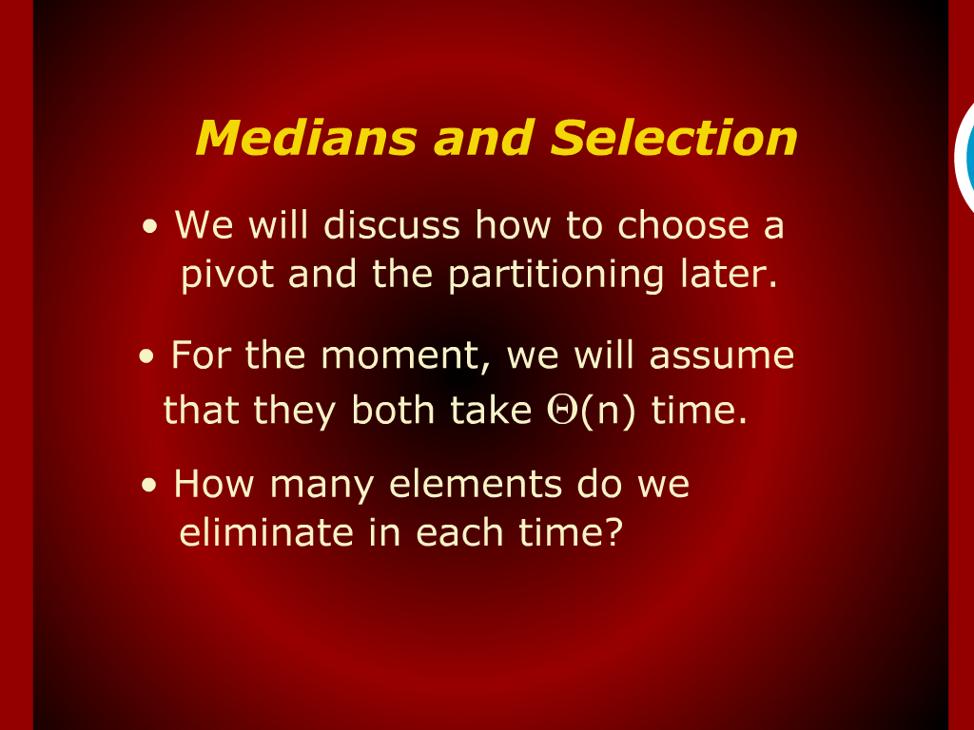
Median and Selection

Slide 4
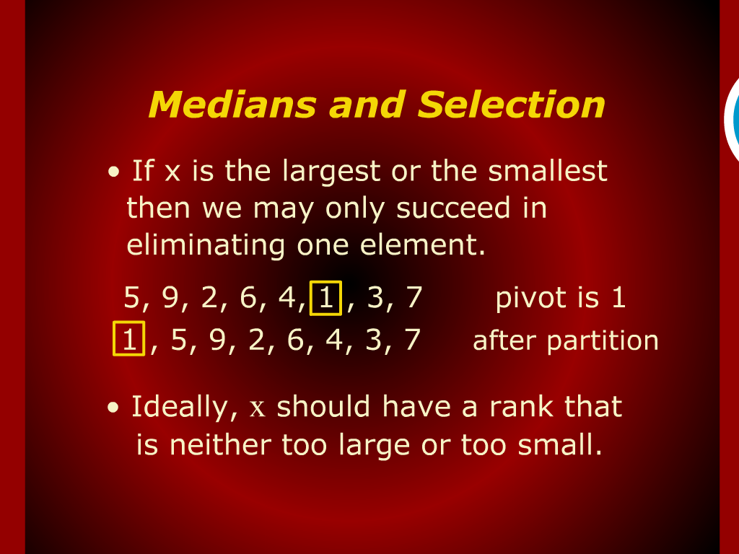
Median and Selection

Slide 5
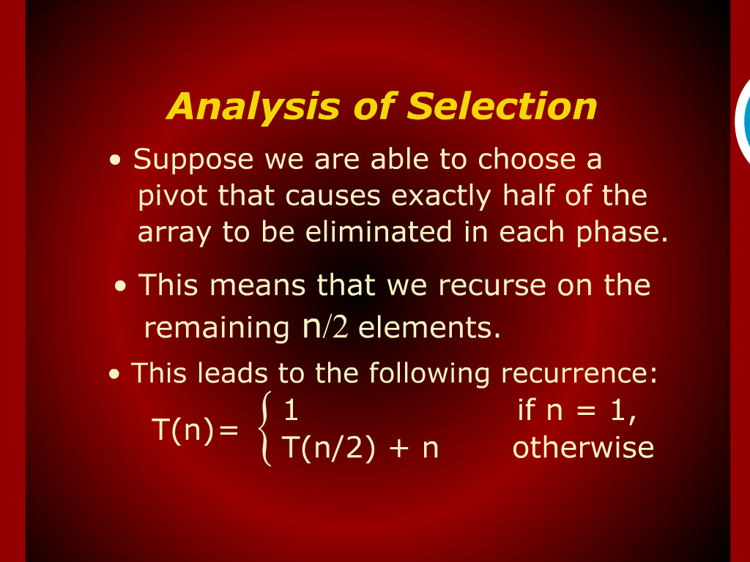
Analysis of Selection

Slide 6
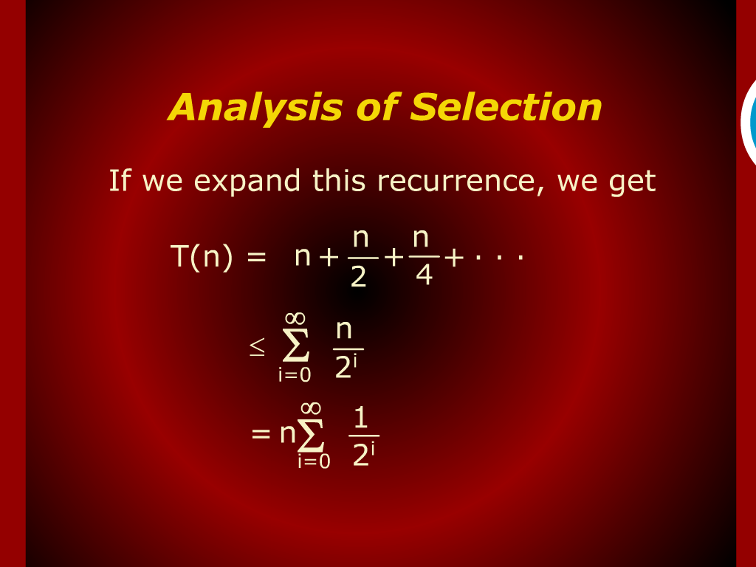
Analysis of Selection

Slide 7
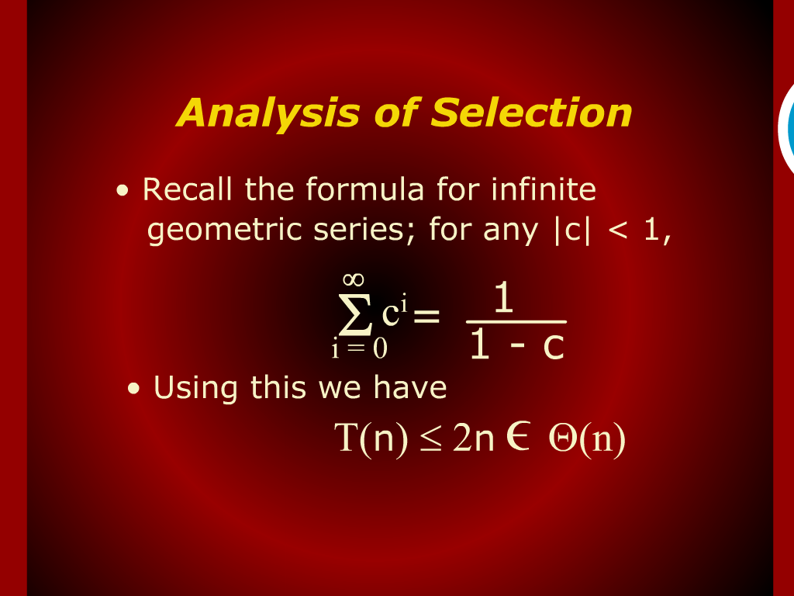
Analysis of Selection

Slide 8
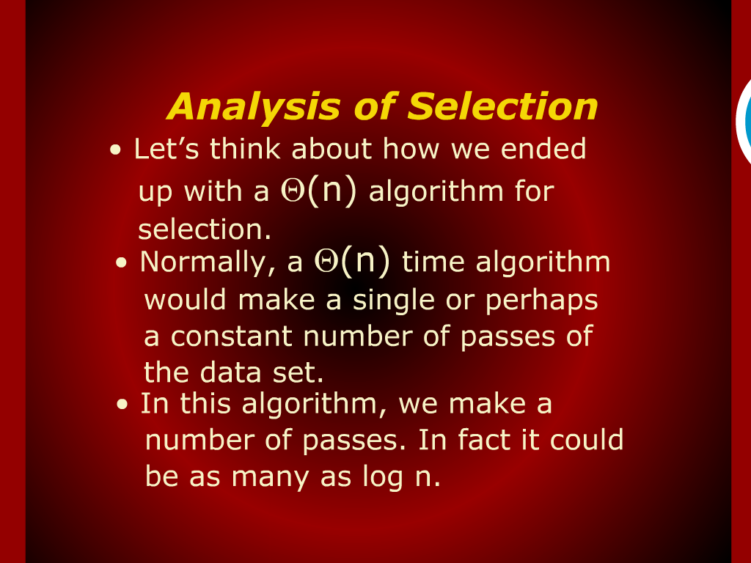
Analysis of Selection

Slide 9
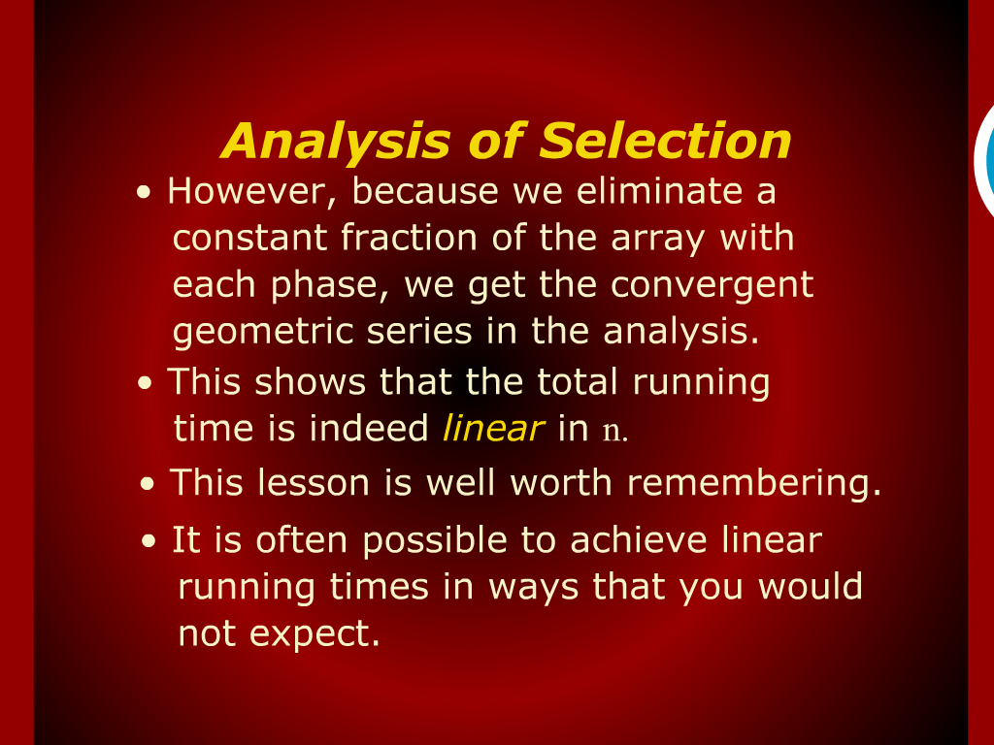
Analysis of Selection

Slide 10
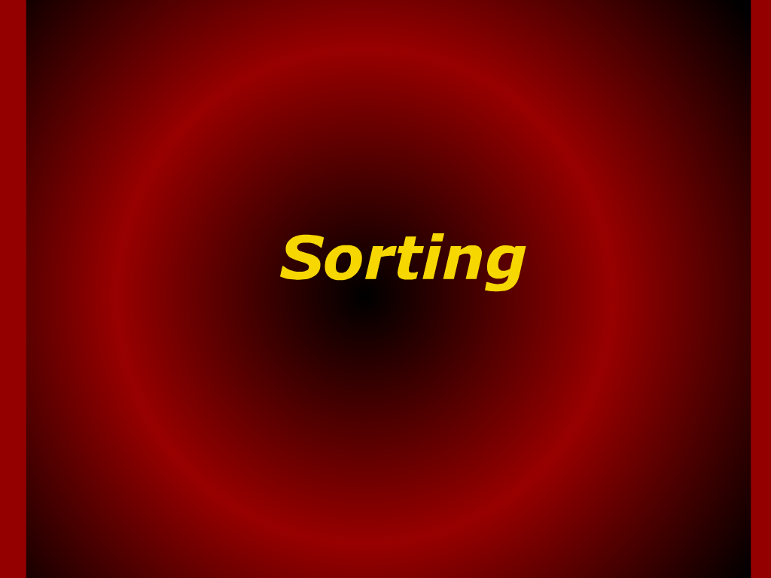
Sorting

Slide 11
Design
and
Analysis of Algorithm

Slide 12
Algorithm
Lecture #11
Sohail Aslam

Slide 13
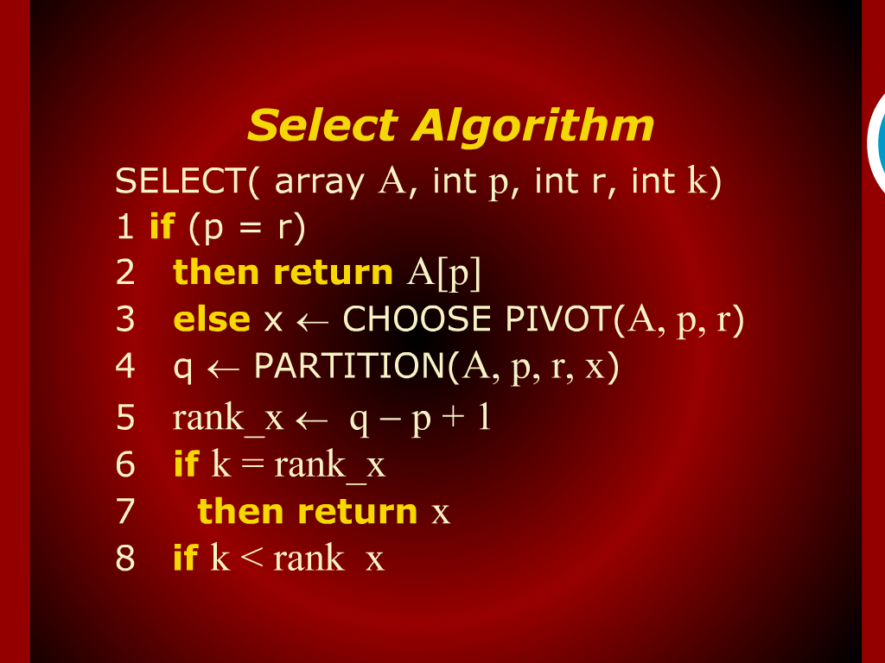
Select Algorithm

Slide 14
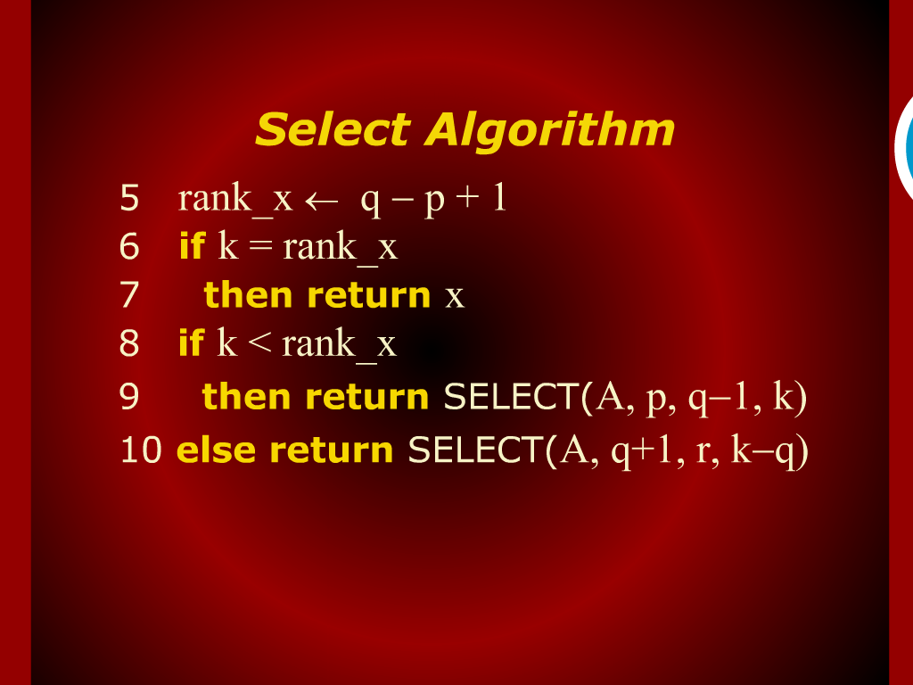
Select Algorithm

Slide 15
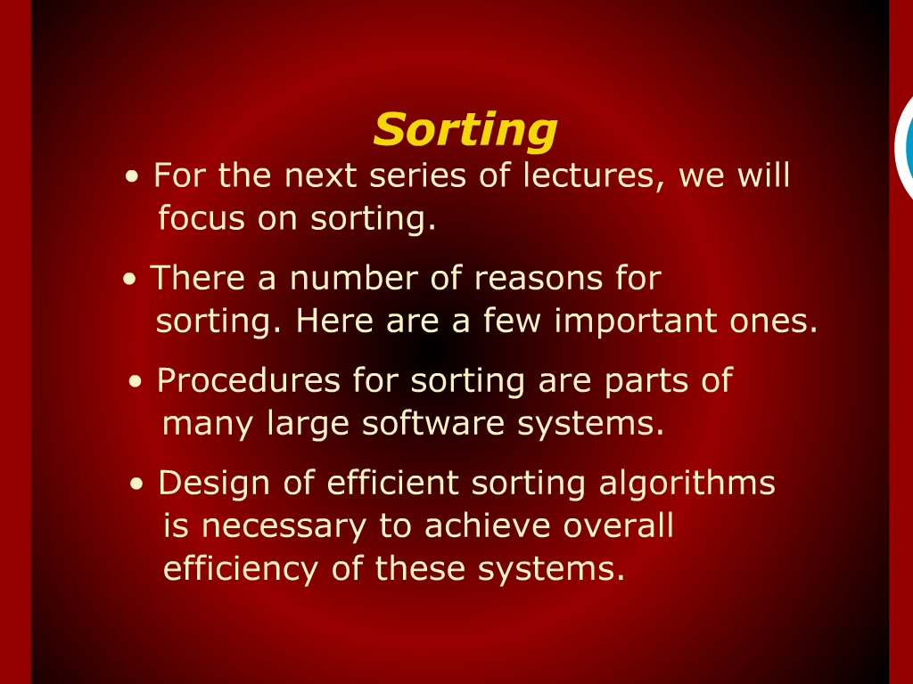

Slide 16
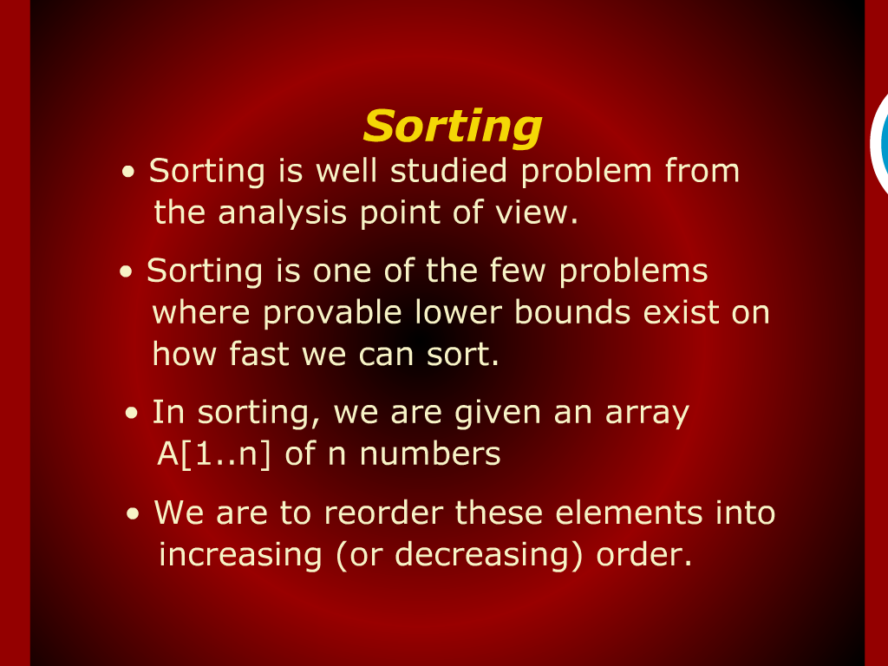

Slide 17
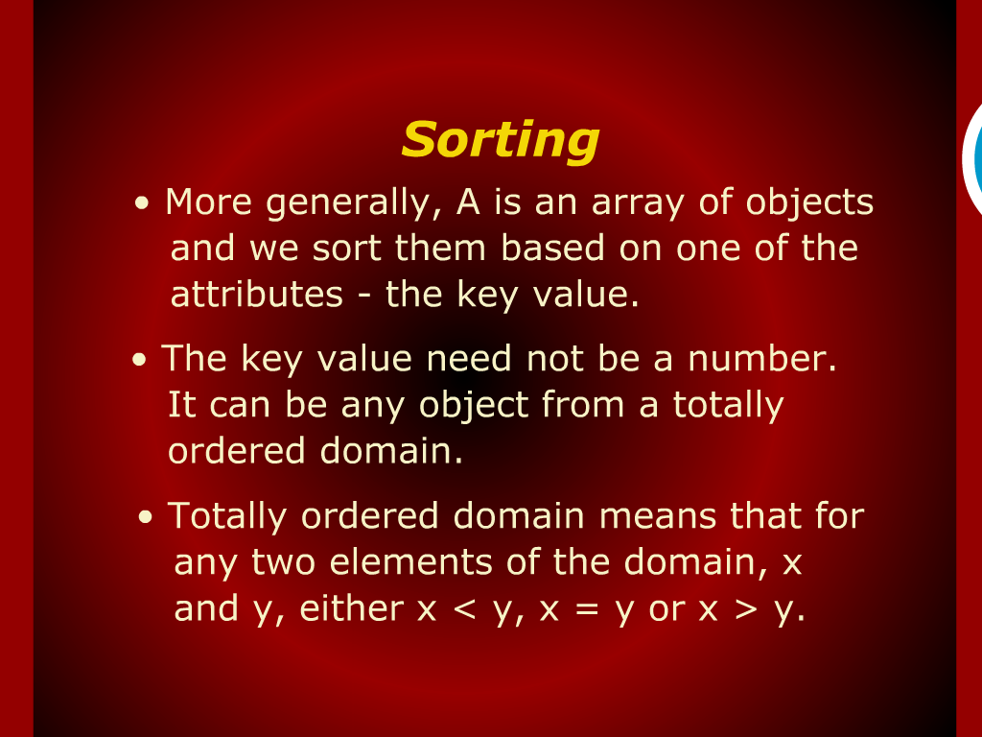

Slide 18
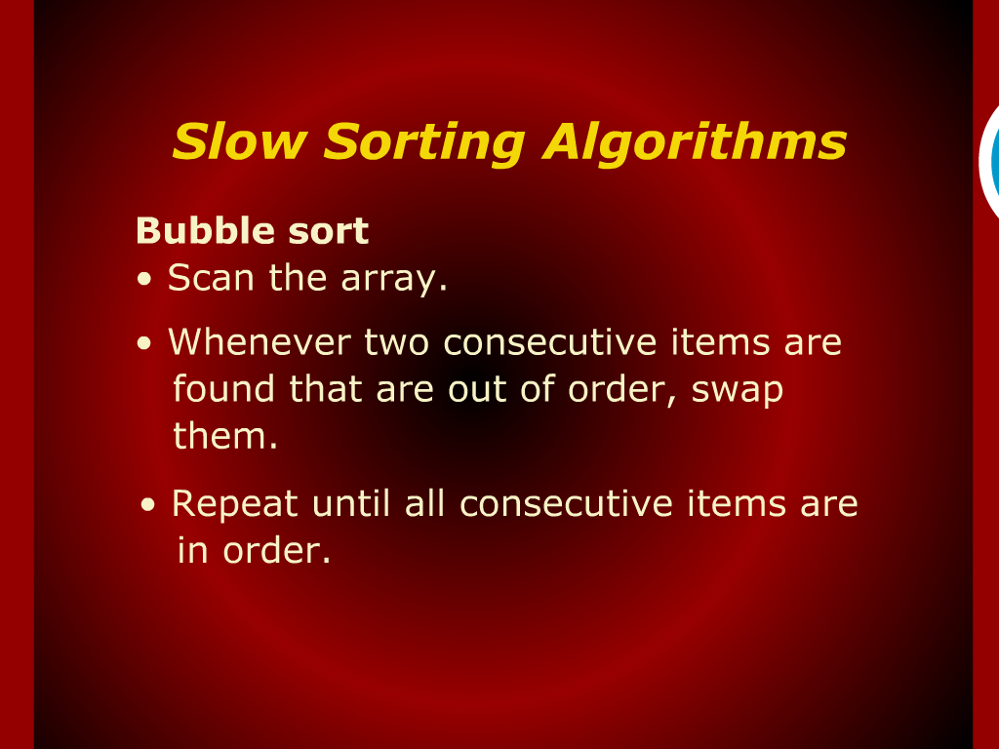

Slide 19
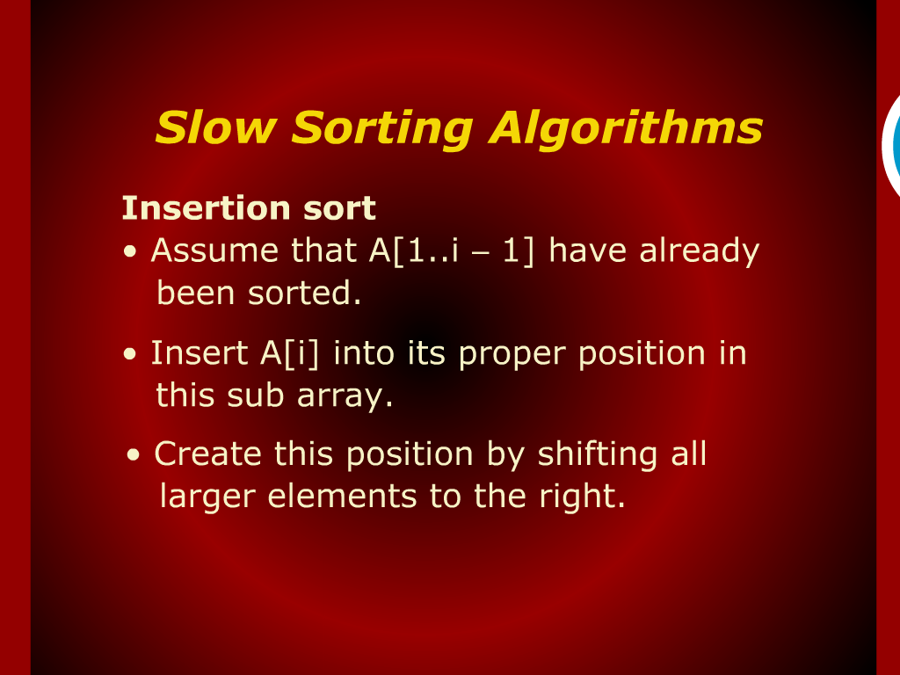

Slide 20
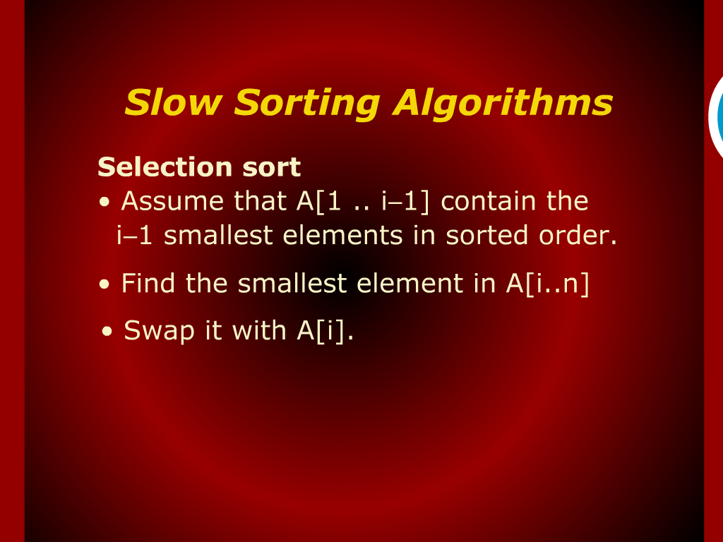

Slide 21
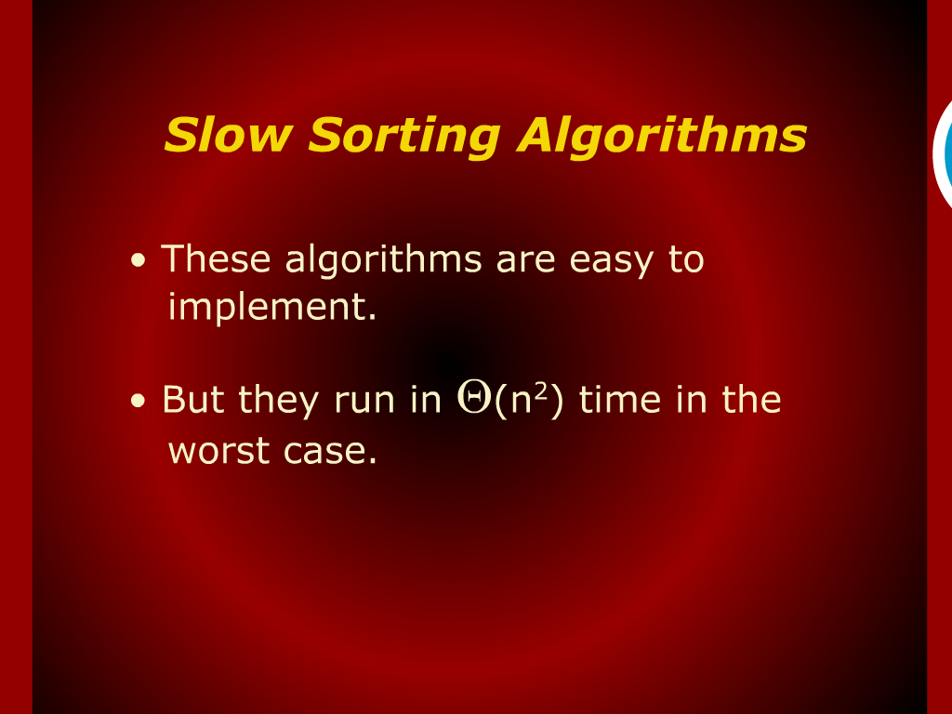

Slide 22
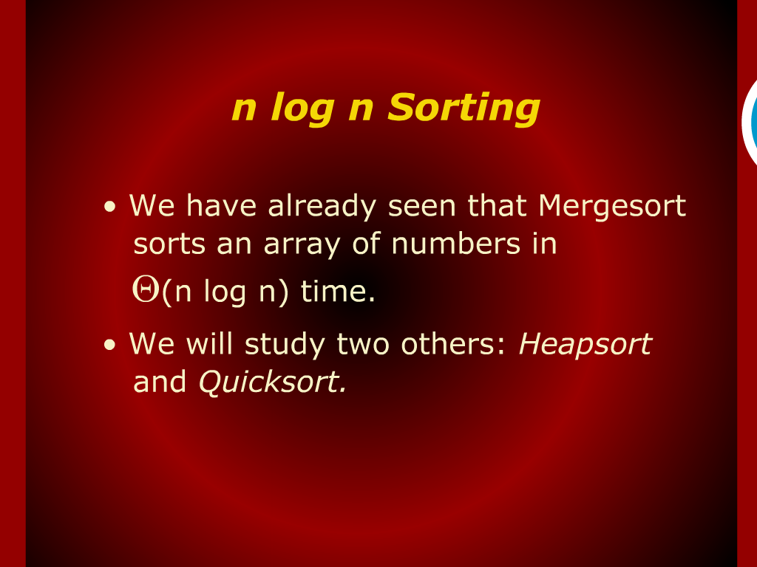

Slide 23
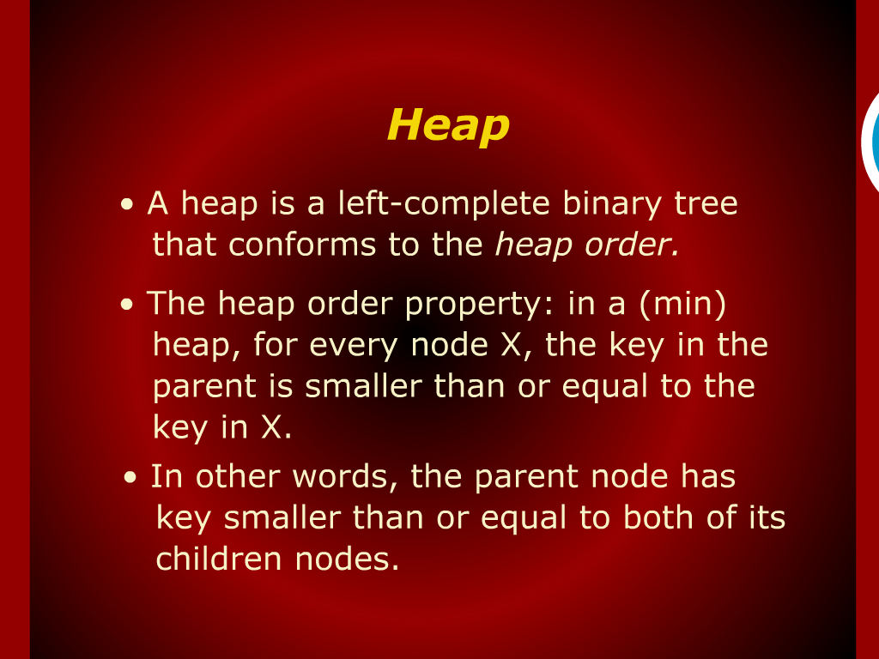

Slide 24
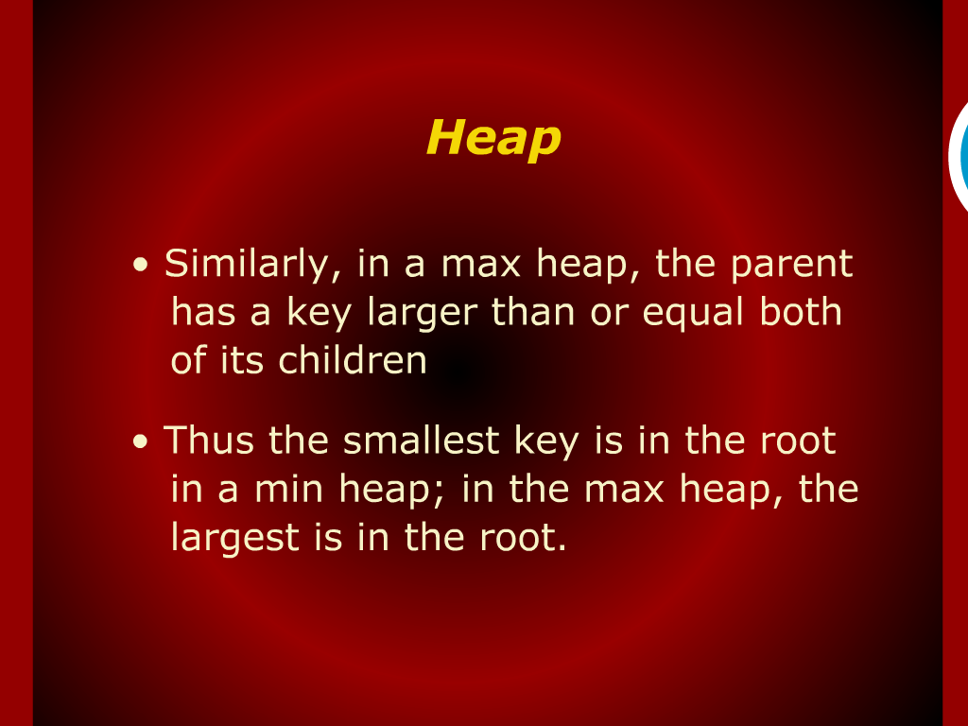

Slide 25
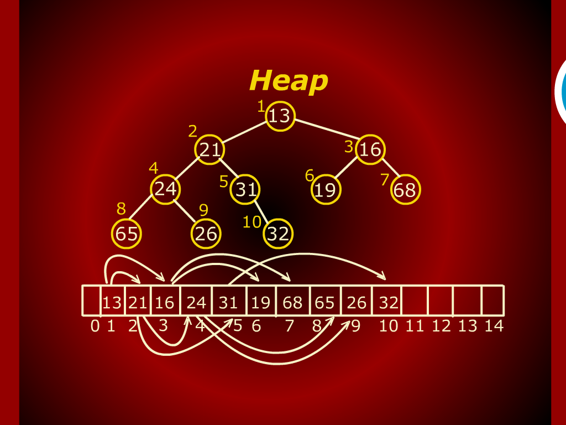

Slide 26
Heap Sort
Quick Sort
O(nlogn)

Slide 27
Bubble Sort
Insertion Sort
Selection Sort
O(n2)

Slide 28
Analysis of Selection

